Slide 1
Mental Health Counselors in Schools: A New Frontier Responsive Interventions Designed to Empower Students (RIDES)
Tami Sullivan & Cory Borsch
RIDES Team: Edward Blanch, Stacy Baum
& Ashley Williams
SUNY Oswego, Counseling and Psychological Services

Slide 2
Key Messages
Schools are where kids are!
College-Public School Partnerships are an efficient way to support the social-emotional and mental health needs of children in a multi-tiered system of supports.
A trauma-sensitive approach supports over 80% of identified at-risk students
Empirical systems that monitor progress, assess outcomes and evaluate programs increase program efficiencies using evidence-based programs

Slide 3
What Does it Mean to be Trauma-Informed?
You recognize and acknowledge trauma and its prevalence, alongside awareness and sensitivity to its dynamics, in all aspects of the work in schools across all systems.

Slide 4
Trauma-Informed Approach
Recognizes and addresses impact of trauma on students.
Infuses and sustains trauma informed awareness knowledge and skills that are evident in practices and professional development.

Slide 5
Trauma
Children can suffer trauma in two distinct ways
Chronic and
Acute
A combination of the two might be considered “complex trauma”

Slide 6
Trauma
Understanding trauma is not just about acquiring knowledge. Its about changing the way you view the world.
It’s about changing the helping paradigm from “What is wrong with you?” to “What happened to you?” (Sandra Bloom, 2007)
Notes:
Many students have had traumatic experiences.
Studies now show that nearly every school has children who have been exposed to overwhelming experiences, such as witnessing violence between their caretakers, being the direct targets of abuse, and other kinds of adversity. The Adverse Childhood Experiences (ACE) study found higher levels of traumatic experiences in the general population than previously imagined. Among the approximately 17,000 adults surveyed, just over 50% reported having experienced at least one form of childhood adversity. These included physical, emotional or sexual abuse; witnessing their mother treated violently; having a parent with substance abuse or mental health issues; or, living in a household with an adult who had spent time in prison.
If we add those who are chronically bullied, experience periods of homelessness, live in the proximity of pervasive community violence, flee war-torn countries, undergo multiple invasive medical procedures, or live with a parent traumatized by recent combat, the number of children affected by significant adversity grows even larger.
Experts explain that trauma is not an event itself, but rather a response to one or more overwhelmingly stressful events where one’s ability to cope is dramatically undermined. These experiences in childhood can lead to a cascade of social, emotional and academic difficulties. As students get older, exposure to traumatic experiences can also lead to the adoption of self-medicating behaviors such as substance abuse, smoking, and overeating. All of these responses to traumatic events can interfere with a child’s ability to learn at school.

Slide 7
Trauma
Traumatic events are external, but they quickly become incorporated into the mind (Terr, 1990) and the body (Van Der Kolk, 1991).
Psychological trauma is characterized by feelings of:
intense fear
helplessness
loss of control
threat of annihilation

Slide 8
Children and Trauma
Children and more vulnerable to the stress of trauma.
The brains of children who experience trauma and toxic stress are wired differently.
Notes:
Children’s responses to trauma are complex and are different from those of adults.
Children’s traumatizing experiences can compromise all areas of childhood development, including identity development, cognitive processing, body integrity, ability to manage behavior, affect tolerance, spiritual and moral development, and ability to trust self and others.
The human brain is a social organ that is shaped by experience, and that is shaped in order to respond to the experience that you’re having. So particularly earlier in life, if you're in a constant state of terror; your brain is shaped to be on alert for danger, and to try to make those terrible feelings go away.
The brain gets very confused. And that leads to problems with excessive anger, excessive shutting down, and doing things like taking drugs to make yourself feel better. These things are almost always the result of having a brain that is set to feel in danger and fear.
As you grow up an get a more stable brain, these early traumatic events can still cause changes that make you hyper-alert to danger, and hypo-alert to the pleasures of everyday life.
The brain is formed by feedback from the environment. It's a profoundly relational part of our body

Slide 9
ACE
Adverse Childhood Experiences refer to inherently disruptive experiences in childhood that produce significant and potentially damaging levels of stress and associated physical changes
The cumulative impact of persistent, early, and multi-factored exposure to adversity

Slide 11
Mental Health Trends
Mental health disorders are the most common health issues faced by our nation’s school-aged children.
One in five children suffers from a mental health or learning disorder.
80% of chronic mental disorders begin in childhood. There is an urgent need to identify the signs of these conditions early in life if children are to get the care and support they need to thrive
Notes:
2016 Children’s Mental Health Report
Mental health disorders are the most common health issues faced by our nation’s school-aged children. One in five children suffers from a mental health or learning disorder, and 80% of chronic mental disorders begin in childhood. There is an urgent need to identify the signs of these conditions early in life if children are to get the care and support they need to thrive.¹
Children struggling with mental health and learning disorders are at risk for poor outcomes in school and in life, and outdated approaches to discipline are only making matters worse. Instead of putting kids further at risk, schools should be identifying and supporting at-risk children. A widely deployed, integrated system of evidence-supported, school-based mental health and preventive services is needed. If we want to help our children and our schools, we cannot wait.

Slide 12
Prevalence
9.5-14.2% of children birth to 5 have social and emotional problems interfering with functioning
21% of children and adolescents in the U.S. meet diagnostic criteria for MH disorder with impaired functioning
16% of children and adolescents in the U.S. have impaired MH functioning and do not meet criteria for a disorder
13% of school-aged, 10% of preschool children with normal functioning have parents with “concerns”
________
50%
*CDC, 2016

Slide 13
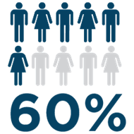
children with mental health problems go untreated

Slide 14
So Why is it so Difficult to Get Mental Health Help for Kids?
“…A fragmented services system is one of several systemic barriers impeding the delivery of effective mental health care. Our interim report describes other problems, including…our failure to intervene early in childhood, and our Nation’s failure to recognize mental health care as a national priority.”
Michael F. Hogan, Ph.D, Chair, President’s New Freedom Commission on Mental Health, 2002.

Slide 15
Impact on Families
Silos lead families to seek services from multiple systems, often unsuccessfully;
Equity and access barriers;
Workforce shortage and wait lists lead to lag time in getting a child services and support; and
A full array of effective services are rarely available

Slide 16
Mental Health and Schools
Psychosocial & MH problems often are major factors interfering with effective school performance of some students so schools must do something about these individuals
Schools are often where students’ mental health needs are discovered and where support is provided
Schools become the de facto providers of MH services
Notes:
The specific mission and purpose of school has long been debated; however, there is general agreement that schools should promote learning for the purpose of creating productive citizens. In the education reform era, schools are held accountable for academic learning through student performance assessments.
Research demonstrates that students with good mental health are more successful in school.
A recent longitudinal study provided strong evidence that interventions that strengthened students’ social, emotional, and decision-making skills also positively affected their academic achievement in terms of higher standardized test scores and better grades (Fleming et al., 2015). Research also demonstrated that there is a societal benefit to investing in the positive mental health of students. For example, it is known that students who are struggling emotionally and behaviorally are more likely to drop out of school. A study by the Teacher’s College at Columbia University (2015) estimated that the United States loses $192 billion (1.6% of the gross domestic product) in combined income and tax revenue with each cohort of students who fail to complete high school.

Slide 17
Service-delivery in Schools
Most school districts deal indirectly with mental health through the work of their student support staff.
A few districts have dealt directly with mental health by establishing mental health units or through School-based Health Centers and through co-located and/or linked community providers.
Enhancement of college-community collaborations

Slide 18
RIDES Programs
Year 1: Rural Alternative Jr & Sr High School
Year 2: Onondaga Nation School
Year 3: Rural High School
Year 4: Rural Middle School
The harmful impacts of marginalization and institutional oppression.

Slide 19
Statistics from Year 2 Project
76% of children live in home with DV/substance abuse/sexual abuse
61% of children are affected by adults incarcerated or have legal issues
75% have significant loss/grief
30% homeless or shared home
59% live in single parent home
96% ACE significant

Slide 20
23
Universal
Targeted
Intensive
Continuum of Support for ALL
Few
Some
All
Notes:
NOTICE GREEN GOES IS FOR “ALL”

Slide 21
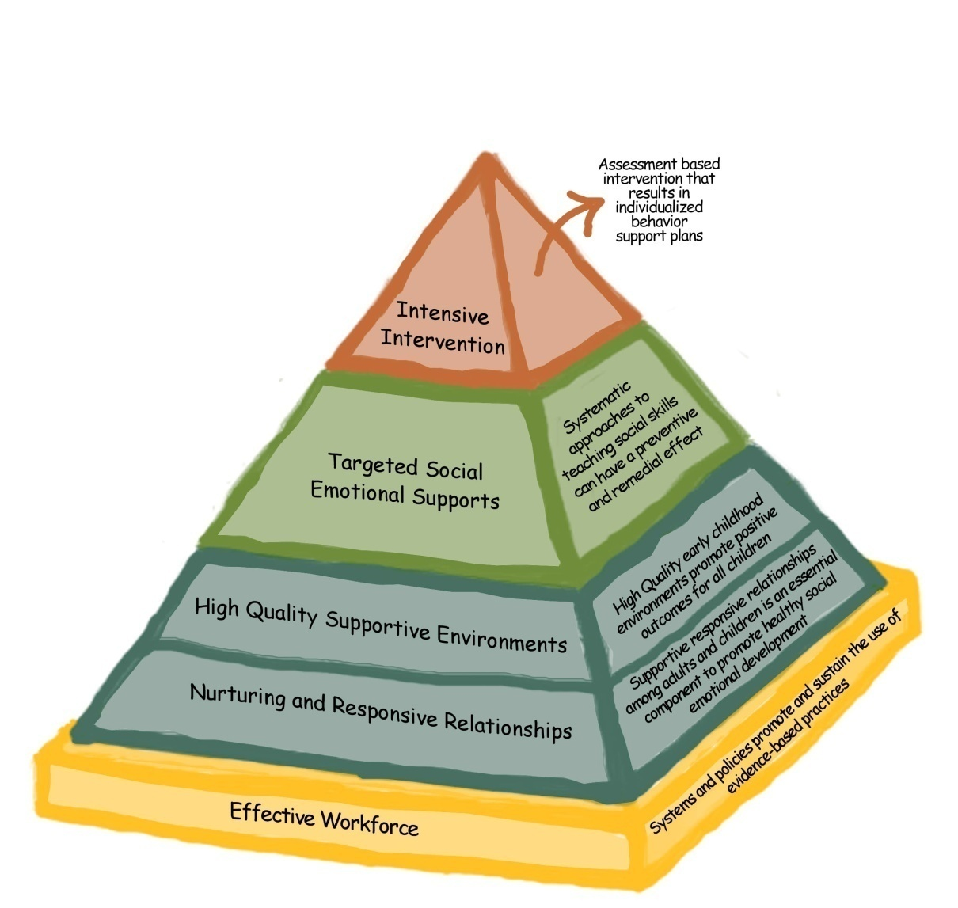

Slide 22
Multi-systemic Model
Responsive Interventions Designed to Empower Students
Three Goals:
Assess mental health needs
Support students’ mental wellness
Empower students’ resilience through trauma-informed practices
Each of these goals helps students develop mental wellness so they can achieve a balance to re-engage in the school learning community to achieve success in multiple facets of their lives.
The curriculum is a unique combination of the best elements of evidence-based mental health interventions and programs.
Each counseling session is tailored to the student’s individual need.
Universal supports: Professional development and professional demonstration projects

Slide 23
Trauma Informed Schools/Systems & Trauma Informed Therapy
TRAUMA INFORMED
TRAUMA SPECIFIC
Takes into account knowledge about trauma into all aspects of service delivery (education, discipline, socialization)
Integrates sensitivity approaches into the school culture for the student body as a whole
Does not diagnose or treat symptoms or syndromes related to trauma
Utilize evidence-based, best practices treatment models that have been proven to facilitate trauma recovery
Directly assesses the individual for trauma
Directly address the impact of trauma on the individual’s life and facilitate recovery based on a relational

Slide 24
Universal: Professional Development
Book Club
Didactic Training
Fostering Resilient Learners (Souers & Hall)
Year-long monthly book group
Teacher demonstration project
Mindful Monday
Yoga-ed
Ecotherapy
5 workshops on school mental health
Each participant develops a trauma-informed classroom plan
PBIS analyzed to adjust to a trauma-informed disciplinarian approach

Slide 25
Behavior Intervention Monitoring Assessment System (BIMAS)
Screening- To detect students in need of further assessment and to identify their respective areas of need.
Student Progress Monitoring- To provide feedback about the progress of individual students or clients.
Program Evaluation- To gather evidence that intervention services are effective.

Slide 26
What is the BIMAS?
3-tier Behavioral Progress Monitoring System
for screening and assessing changes in response to behavior intervention
follows the RTI model
School-aged children and adolescents (5-18)
2 main components: BIMAS Standard & BIMAS Flex
Multi-informant tool with forms for teachers, parents, youth, and clinician
web-based data management and reporting system.
Notes:
26

Slide 27
Interpretation of BIMAS Scores : Scale-level Descriptors
Behavior Concern Scales (↑ scores = )
High Risk: T = 70+
Some Risk: T = 60-69
Low Risk: T < 60
Adaptive Scales (↑ scores = )
Strength: T = 60+
Typical: T = 41-59
Concern: T ≤ 40

Slide 28
Interpretation of BIMAS Scores: Item-Level Descriptors (Useful in Individualized Intervention Design)
Likert Scale
0 = Never;
1 = Rarely;
2 = Sometimes;
3 = Often;
4 = Very Often
Item Descriptors:
Behavior Concern Scales
No Concern
Mild Concern = M + 1SD; ≥ 75th percentile
Concern = >1 SD; ≥ 84th percentile
Adaptive Scales
Concern = ≤10th percentile
Mild Concern = 10th - 20th percentile; M - 1SD
Fair
Positive = ≥ 75th percentile; M + .67SD
Notes:
28

Slide 29
Baseline Report from BIMAS
BIMAS Reports\RIDES Baseline Self Report_OMS Feb 2018.pdf

Slide 30
Mental Health Assessments
Depression Inventory
Anxiety Inventory
Executive Functioning
Emotional Regulation
Stress
Trauma
Behavior Checklist

Slide 32
Outcomes Typically:
Symptom Reduction and Improved Functioning
Improved school attendance and performance;
Improved family and peer relationships;
Decreased involvement with law enforcement and the juvenile justice system;
Decreased rates of substance use and abuse; and
Reduction in self-harm and suicide related behaviors.

Slide 33
Panelists
Edward Blanch
Stacy Baum
Ashley Williams
Facilitated by Cory Brosch

Slide 34
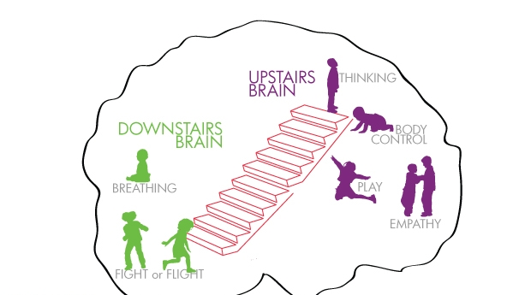
Upstairs/Downstairs Brain
https://heartmindonline.org/resources/daniel-siegel-flipping-your-lid

Slide 35
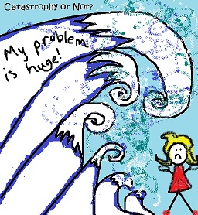
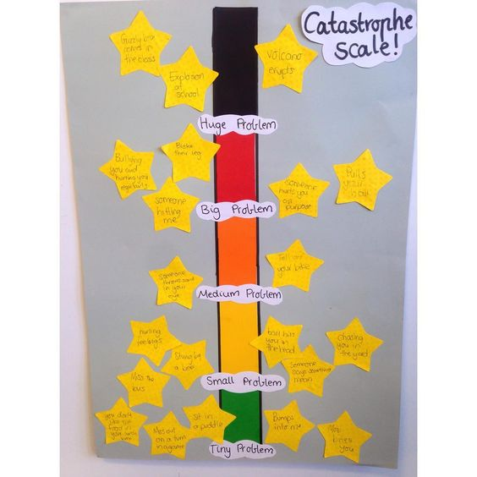
Trauma-Informed Therapeutic Interventions
Turning rage & helplessness into constructive action
Catastrophe Scale Activity

Slide 36
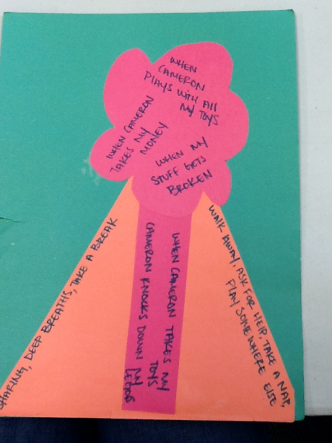
Trauma-Informed Therapeutic Interventions
Increase emotional control
Address anger regulation & expression
Anger Volcano

Slide 37
Trauma-Informed Therapeutic Interventions
Relax-Reframe-Cope
Mindfulness: https://www.youtube.com/watch?v=vzKryaN44ss
Cognitive Restructuring
Leaves on a Stream
5-Steps to Balanced Thinking

Slide 38
Trauma-Informed Therapeutic Interventions
Value Clarification, Increase Management, Engagement & Academic Success
Value House Activity

Slide 39
Trauma-Informed Therapeutic Interventions
Growth Mindset
Cognitive restructuring
Mantras that move mountains
Neuroplasticity
Books

Slide 40
Mantras that Move Mountains
“It might not be OK now, but it will be OK soon enough.”
“I’m stronger than I think — I’ve been through this before and I’m still here.”
“I am peace. I am calm. Breathe.”
“It’s only a moment.”
“I got this.”
“You are bigger than your fear!”
“I am strong enough to get through this.”

Slide 41
Trauma-Informed Therapeutic Interventions
Relaxation:
Go Zen Resource:
animated shorts: https://www.youtube.com/watch?v=aIC-Io441v4&t=220s

Slide 42
Contact Tami at: tamara.sullivan@oswego.edu

Slide 43
References
Foster, S., Rollefson, M., Doksum, T., Noonan, D., Robinson, G., Teich, J. (2005). School Mental Health Services in the United States, 2002––2003. DHHS Pub. No. (SMA) 05-4068. Rockville, MD: Center for Mental Health Services, Substance Abuse and Mental Health Services Administration. http://mentalhealth.samhsa.gov/publications/allpubs/sma05-4068/
Kutash, K., Duchnowski, A.J. & Lynn, N. (2006). School-Based Mental Health: An Empirical Guide for Decision-Makers. http://rtckids.fmhi.usf.edu/rtcpubs/study04/index.htm

Slide 44
References
Merikangas, K.R., He, J., Burstein, M., Swanson, S.A., Avenevoli, S., Cui, L., Benjet, C., Georgiades, K., Swendsen, J., (2010). Lifetime Prevalence of Mental Disorders in US Adolescents: Results from the National Comorbidity Study-Adolescent Supplement (NCS-A). Journal of the American Academy of Child and Adolescent Psychiatry. 49(10): 980-989. doi: 10.1016/j.jaac.2010.05.017
U.S. Department of Education, National Center for Education Statistics. (2015). Digest of Education Statistics. Retrieved from: https://nces.ed.gov/fastfacts/display.asp?id=65

